Slide 1

Tutorial 10
Assignment2& Heap
Notes:
hello everyone, this is the tutorial 10, today, firstly, we will explain the question 2 and question 4 in the assignment 2 and explain some exercises

Slide 2
Outline
Assinment2（Problem2&4）
Heap-Exercise

Slide 3
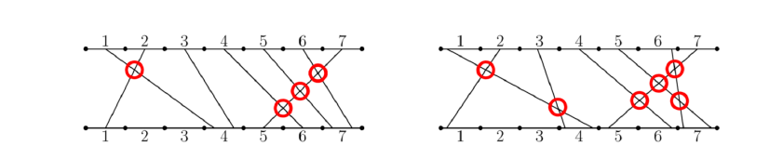
Problem2
You are given an array a of length n. For all i = 1, 2, , n, there should be a straight wire from some
point on segment i of the top terminal to some point on segment ai of the bottom terminal. You can’t
select the endpoints of a segment. For example, the following pictures show two possible wirings if
n = 7 and a = [4, 1, 4, 6, 7, 7, 5].
What is the maximum number of crossings there can be if you place the wires optimally?
Notes:
Let’s first recall the problem2.
It means the segment 1 in the top terminal must point on segment a[1] (i.e., 4)

Slide 4
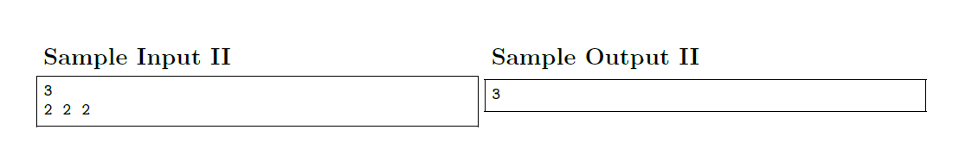
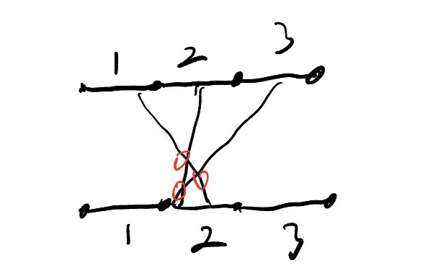
Other Example
Notes:
There is a more detailed example
In this case, we can have three crossings at most.

Slide 5
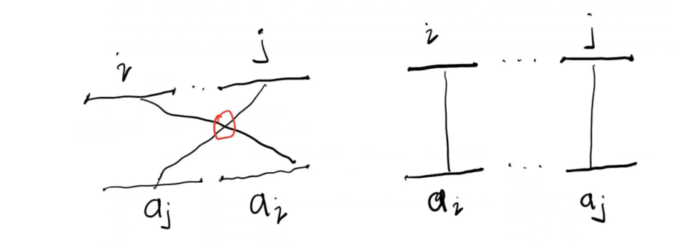
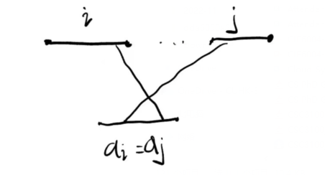
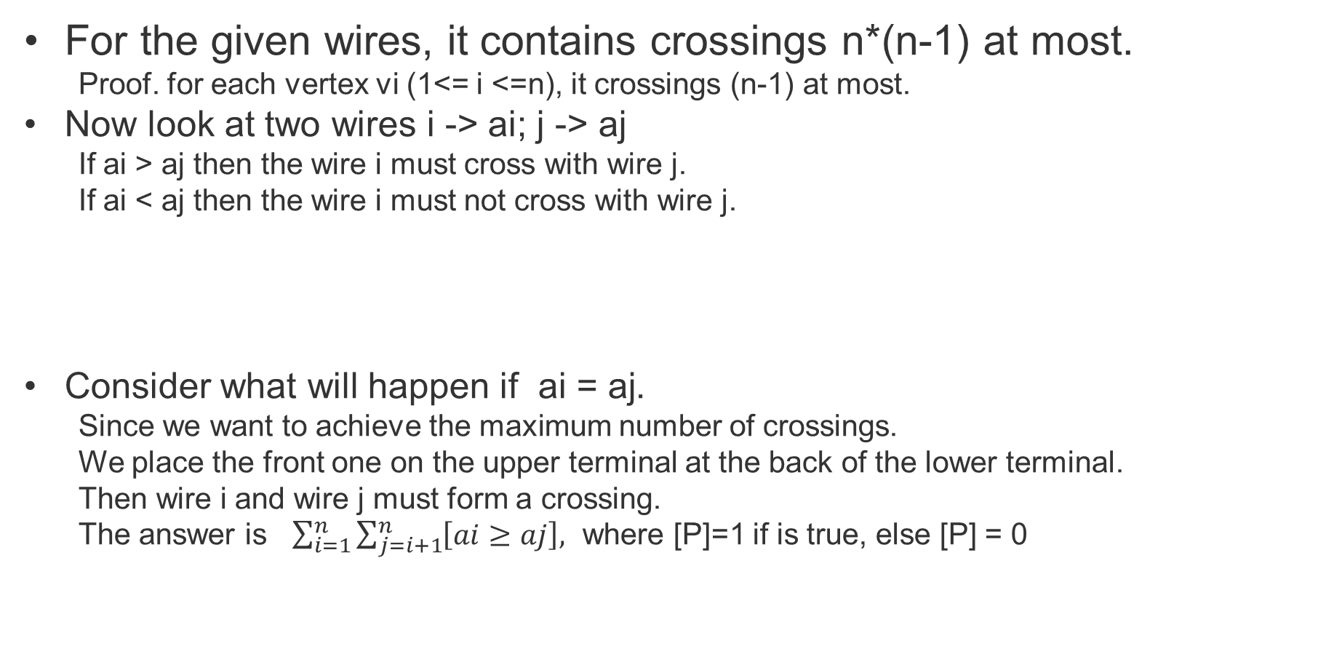
Solution:
For the given wires, it contains crossings n*(n-1) at most.
  Proof. for each vertex vi (1<= i <=n), it crossings (n-1) at most.
Now look at two wires i -> ai; j -> aj
  If ai > aj then the wire i must cross with wire j.
  If ai < aj then the wire i must not cross with wire j.
Consider what will happen if ai = aj.
  Since we want to achieve the maximum number of crossings.
  We place the front one on the upper terminal at the back of the lower terminal.
  Then wire i and wire j must form a crossing.
  The answer is $\sum_{i=1}^{n}{\sum_{j=i+1}^{n}{\left[ai≥aj\right],}}$ where [P]=1 if is true, else [P] = 0

Slide 6
Problem Simplification
逆序对的定义如下：对于数列的第 ii 个和第 jj 个元素，如果满足 i<ji<j 且 a[i]>a[j]a[i]>a[j]，则其为一个逆序对；否则不是。
Given a series of integers of length n, calculate the number of inverse pairs in the series.
An inverse pair is defined as follows: for the i-th and j-th elements of a series, it is an inverse pair if it satisfies i<j and a[i]>=a[j]; otherwise it is not.
Of course, We have an trivial double loop algorithm, but its so time-consuming!
Notes:
We can iterate over all i and j to calculate the final result

Slide 7
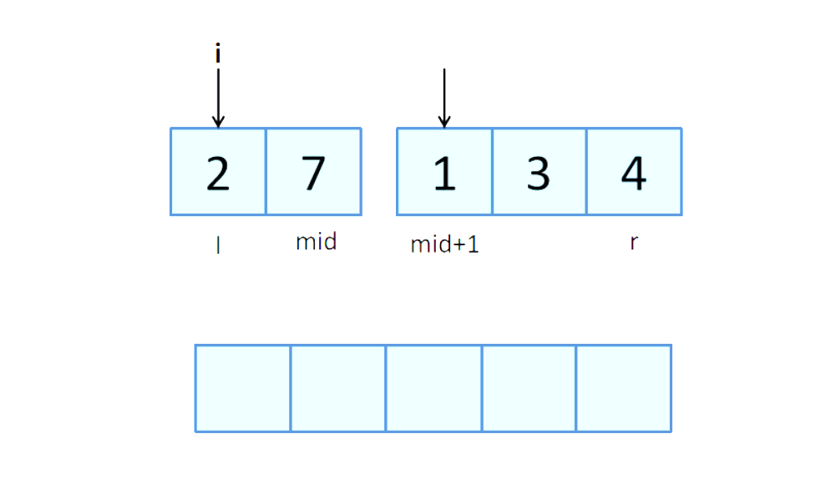
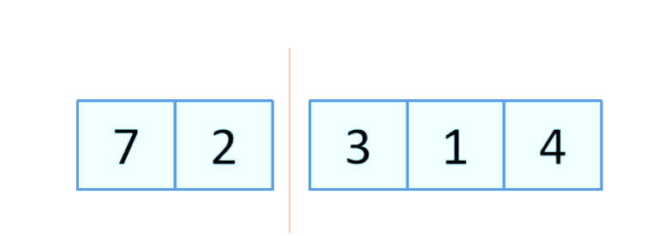
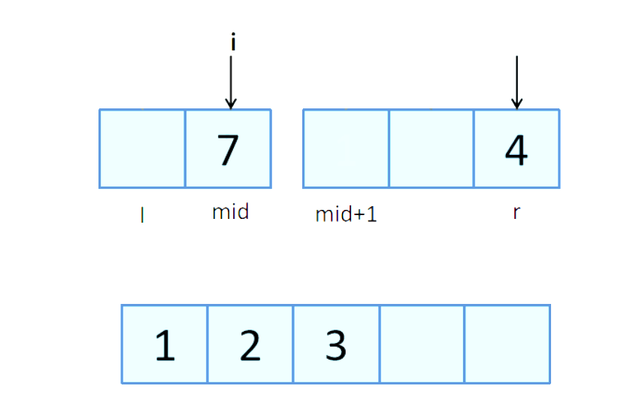
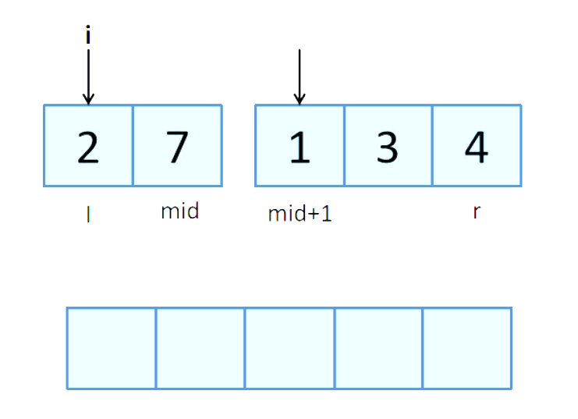
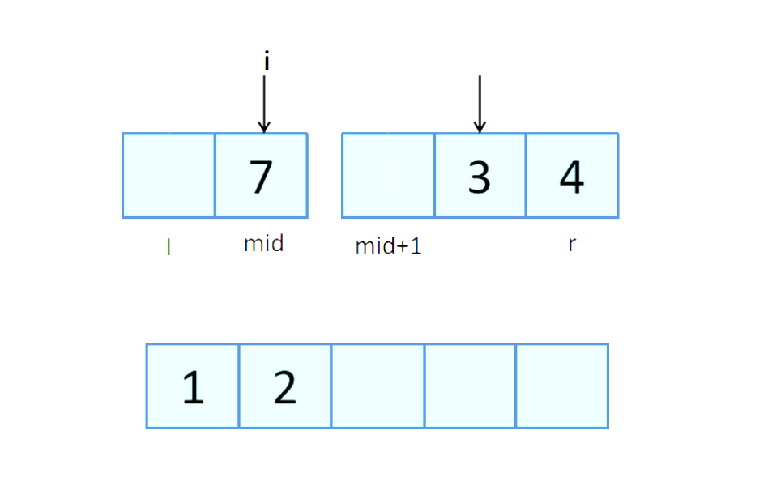
Merge Sort to Solve this problem.
Calculate the number of inverse pairs in the merge process
If a[i] > a[j], then a[i] and the elements after it are greater than a[j], and a[i] constitutes the number of inverse pairs: res += mid - i + 1;
Two sorted Merged segments
a[i] > a[j] (2 > 1)
res += 1 – 0 + 1 = 2
a[i] > a[j] (7 > 4)
res += 1 – 1 + 1 = 4
I = 0, j = mid + 1
a[i] > a[j] (7 > 3)
res += 1 – 1 + 1 = 3
Notes:
We use the following example to illustrate this process

Slide 8
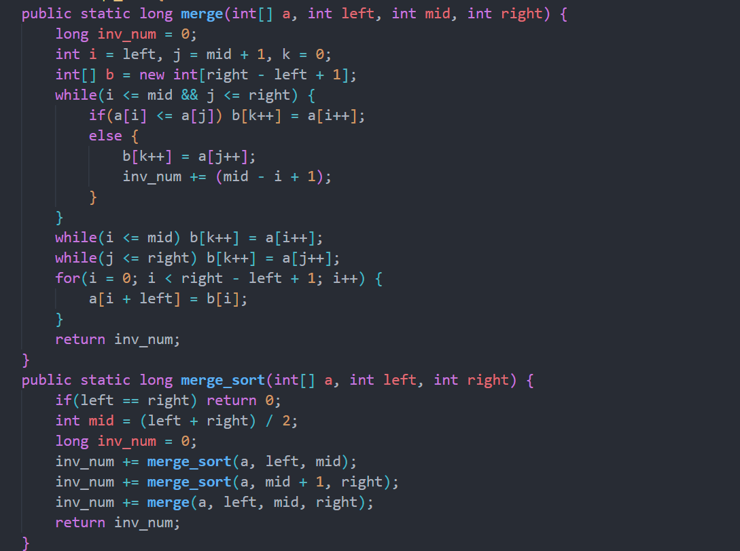
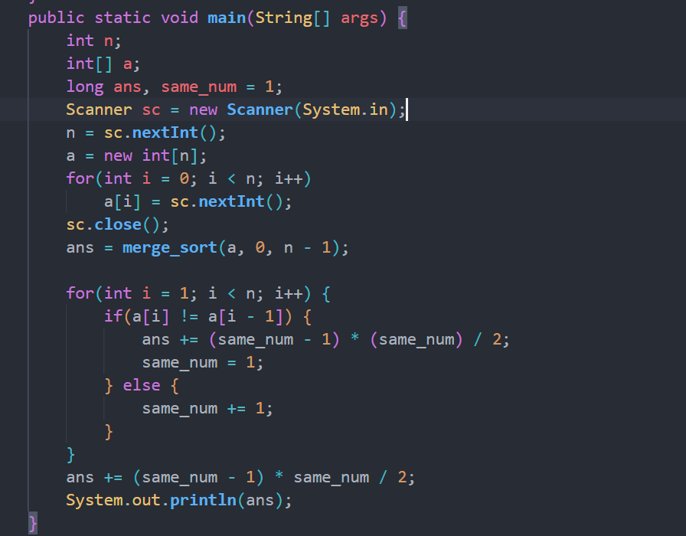
Problem2 Solution: (Java)
Notes:
We can see this is a classical mergesort code, we can see in the merge process we calculate the number of inverse pairs. And this code have already uploaded into the bb

Slide 9
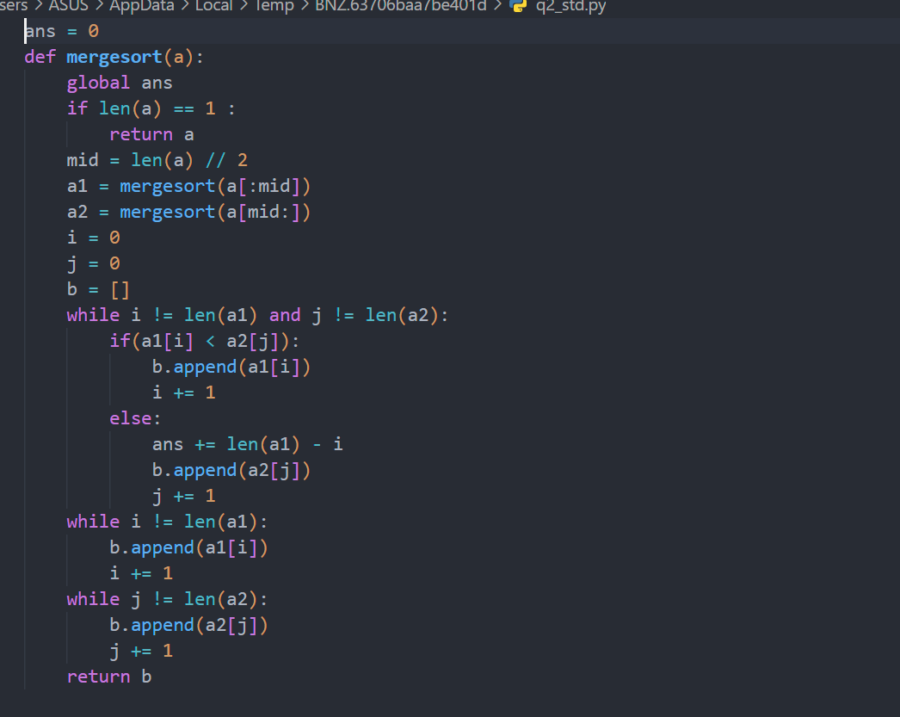
Problem2 Solution: (Python)

Slide 10
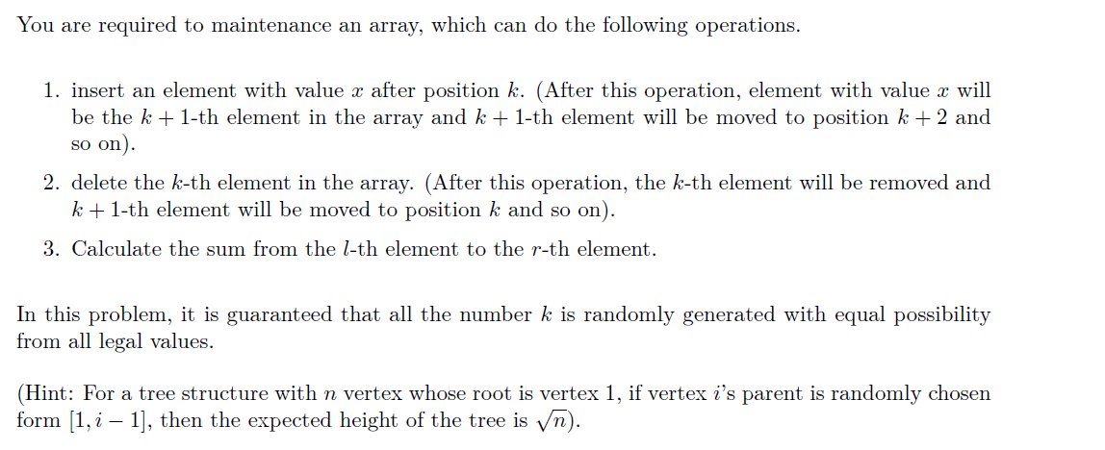
Problem4

Slide 11
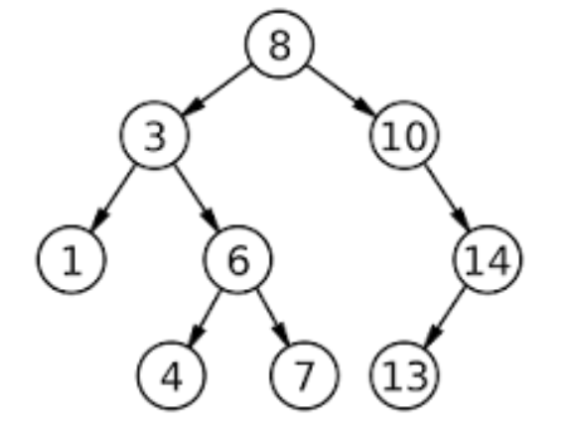
Recap
Binary Search Tree(BST)
BST is a tree such that for each node T
  the key values in its left subtree are smaller than the key value of T
  the key values in its right subtree are larger than the key value of T

Slide 12

Solution
Build a bst to maintain the array.
For each node of the bst, the key is the element's position in the array, the value is the element's value.
In order to maintain the key of each node efficiently, we define :
When inserting or deleting a node, we can get the key of each node by finding the size value of its left child and the remains of the previous node. Then we can insert or delete a node as we do in a common bst.
After inserting a node or deleting a node, there will be at most O(h) node's size changed, where h is the height of the bst

Slide 13

Solution
Then we can solve the insert and delete operation in O(h)
Still, we can maintain the sum as we do to maintain size. we define :
If we need to calculate sum(1,r) , it can be reformulated to sum(1,r) – sum(1, l – 1) .
We can caculate sum (1, x) in O(h) since we have maintained sum for each node.
1
2
3
4
1
3
6
10
Array
Pre-Sum Array
Notes:
So it's kind of like a prefix summation array

Slide 14
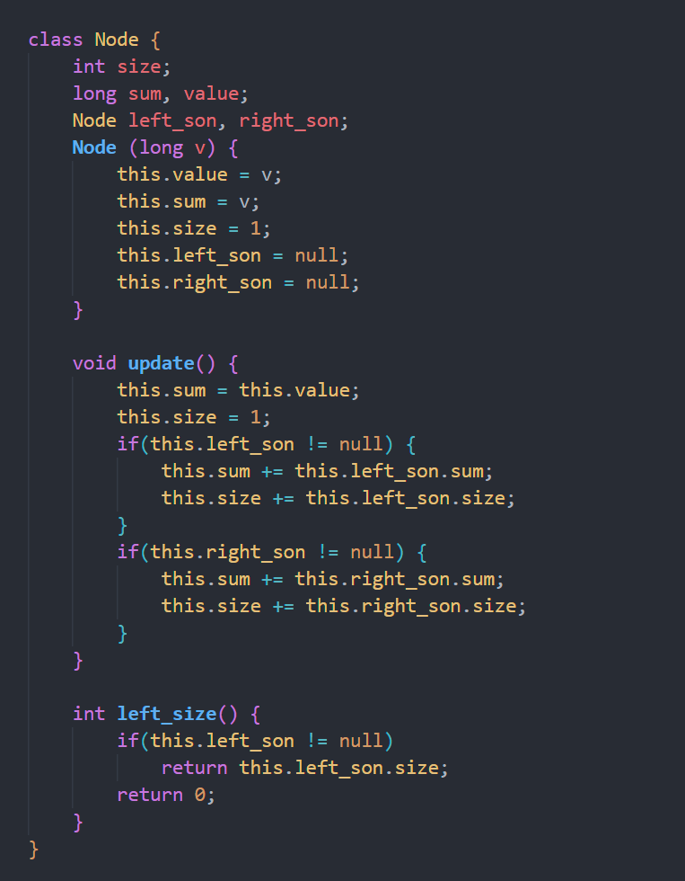
Details: Struct
For each node, we initialize its size = 1, and val = input value,
We need to maintain two values
this.size = its subtree size + 1(it self)
this.sum = its subtree sum value + (this.value)
Integrating information from subtrees

Slide 15
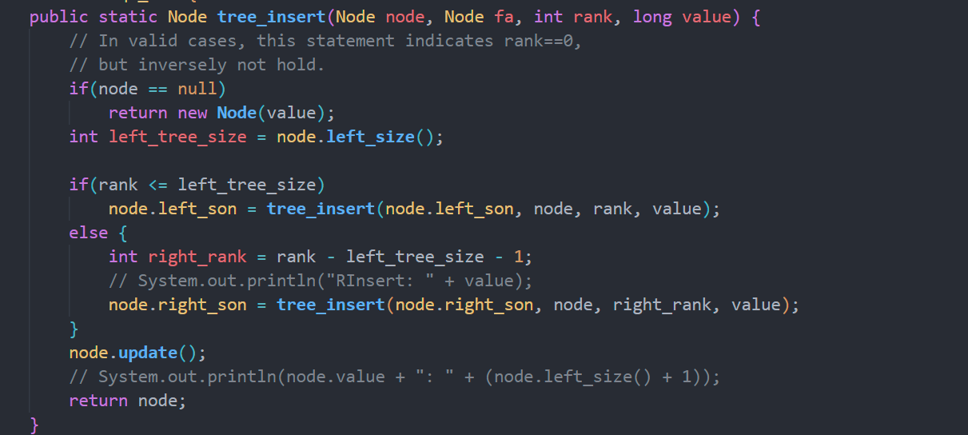
Details: Insert
Determining whether to insert a left or right subtree

Slide 16
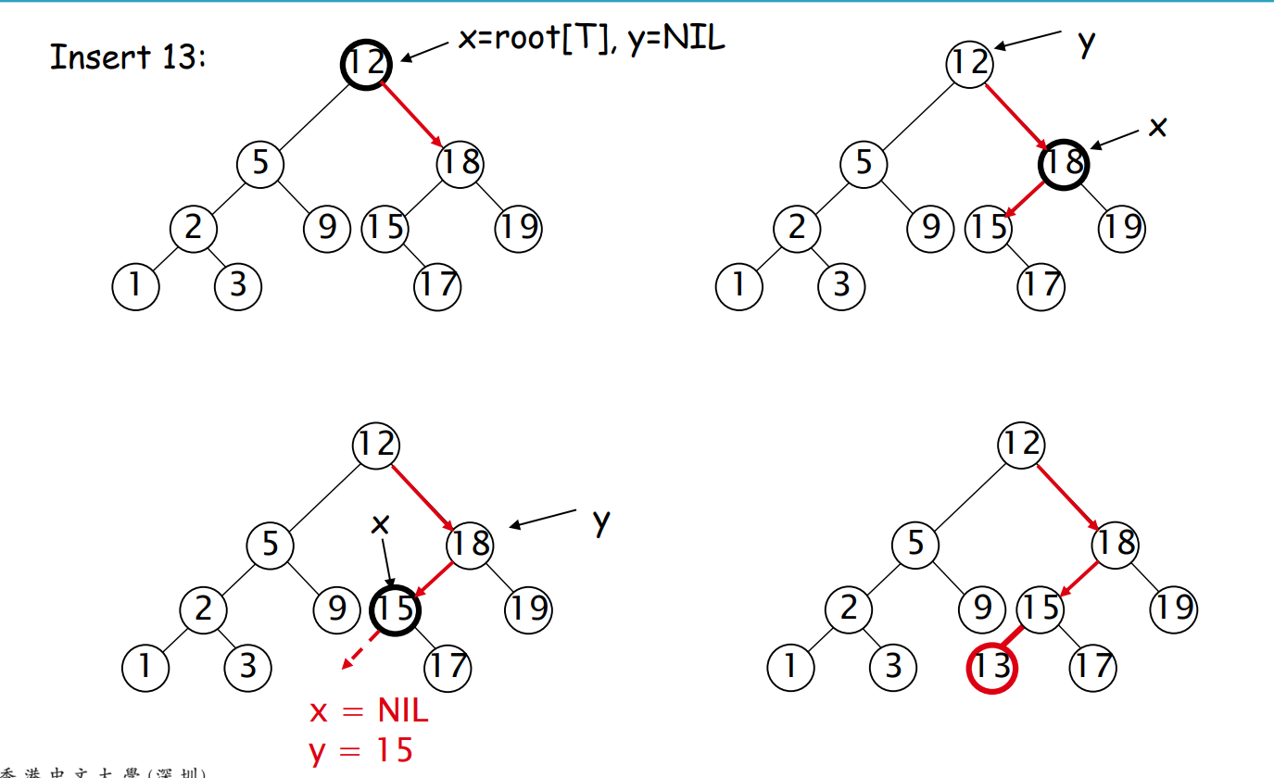
BST: Insert

Slide 17
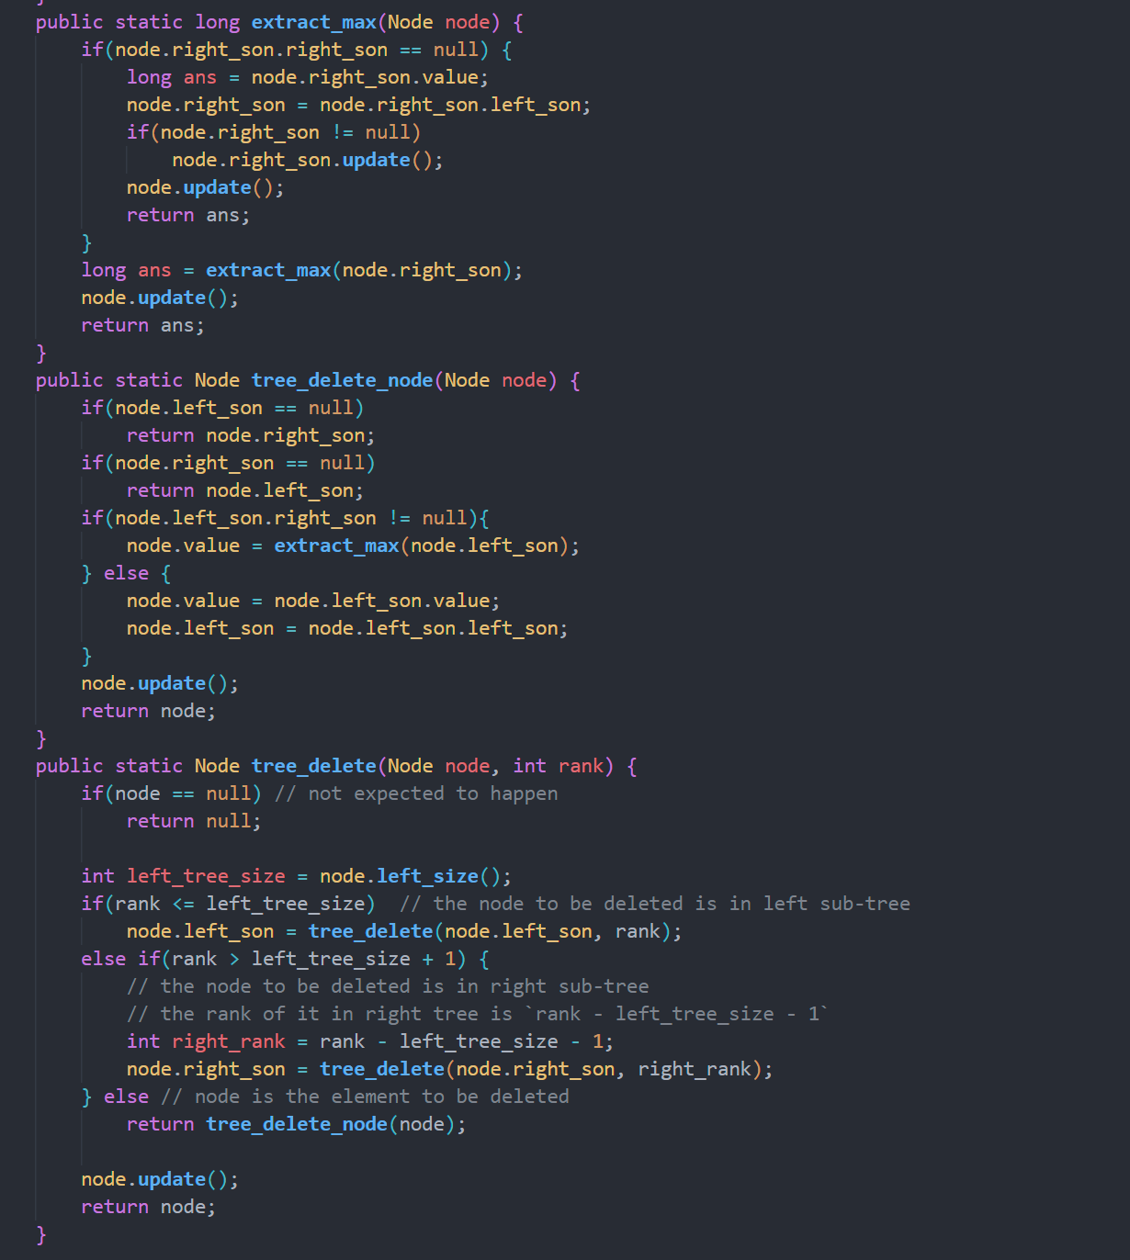
Details: Delete
Delete the node in the left subtree
Delete the node in the right subtree
Delete the root node
Notes:
delete is also very similar to the normal bst deletion.
After the node is deleted, we also need to update the information

Slide 18
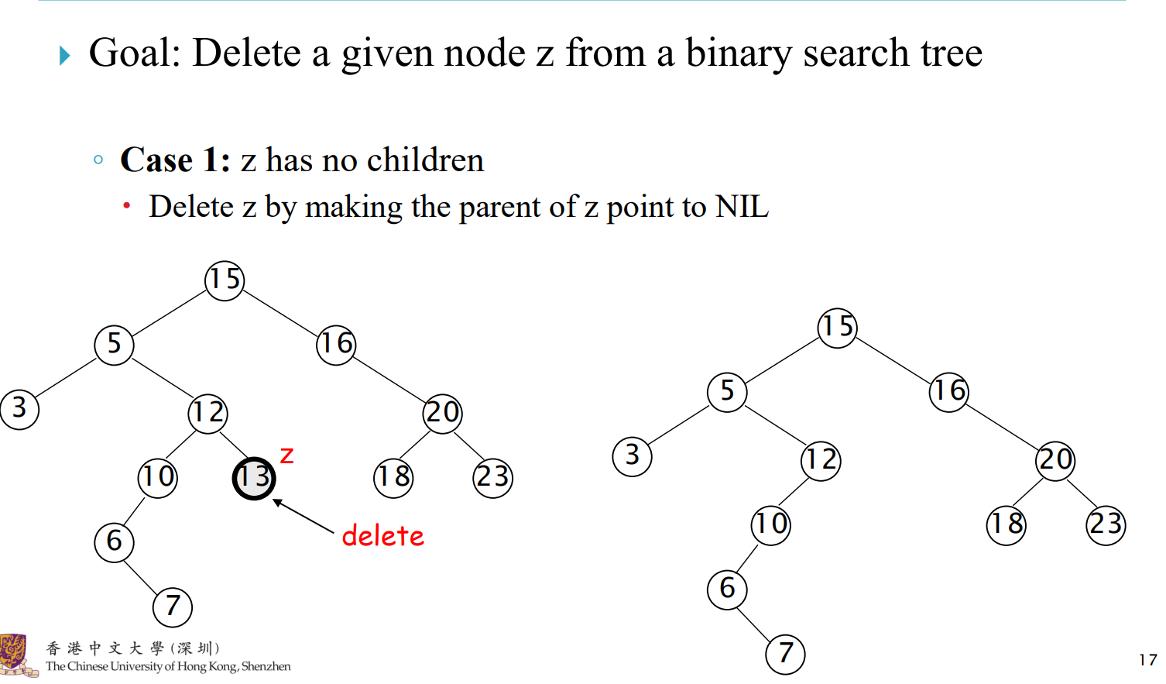
BST: Delete-1

Slide 19
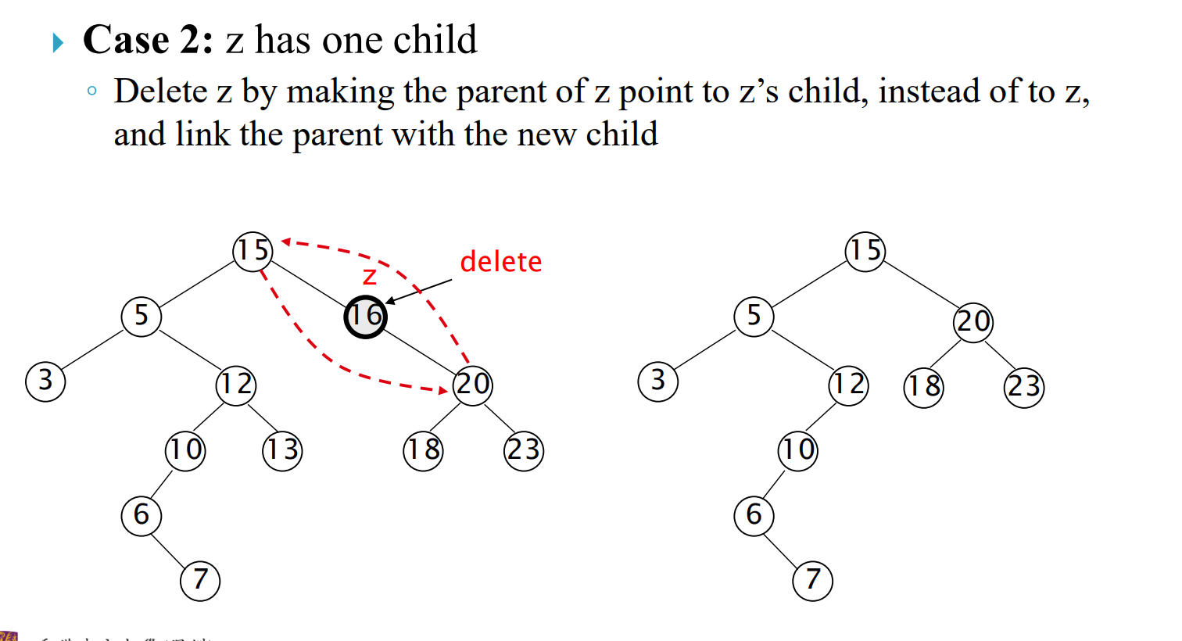
BST: Delete-2

Slide 20
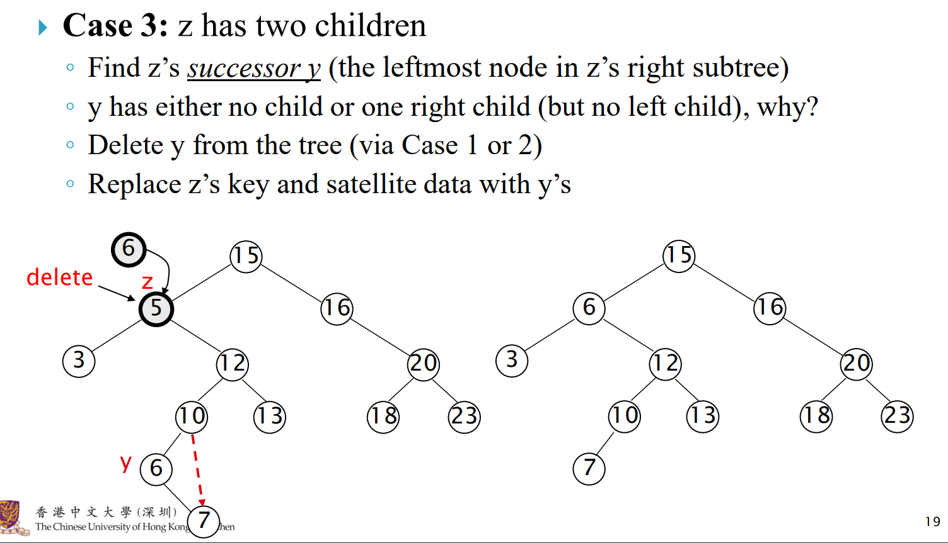
BST: Delete-3

Slide 21
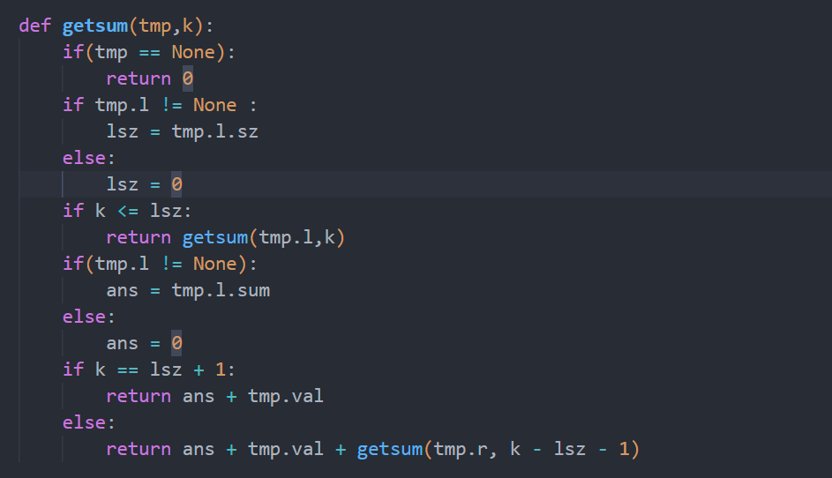
Details: Sum
Root
L
R
1. K <= L.size
Get the sum in the left sub-tree
2. K > L.size
Return L.sum + root.val +
get the (k – L.size + 1)’s sum in the right sub-tree

Slide 22
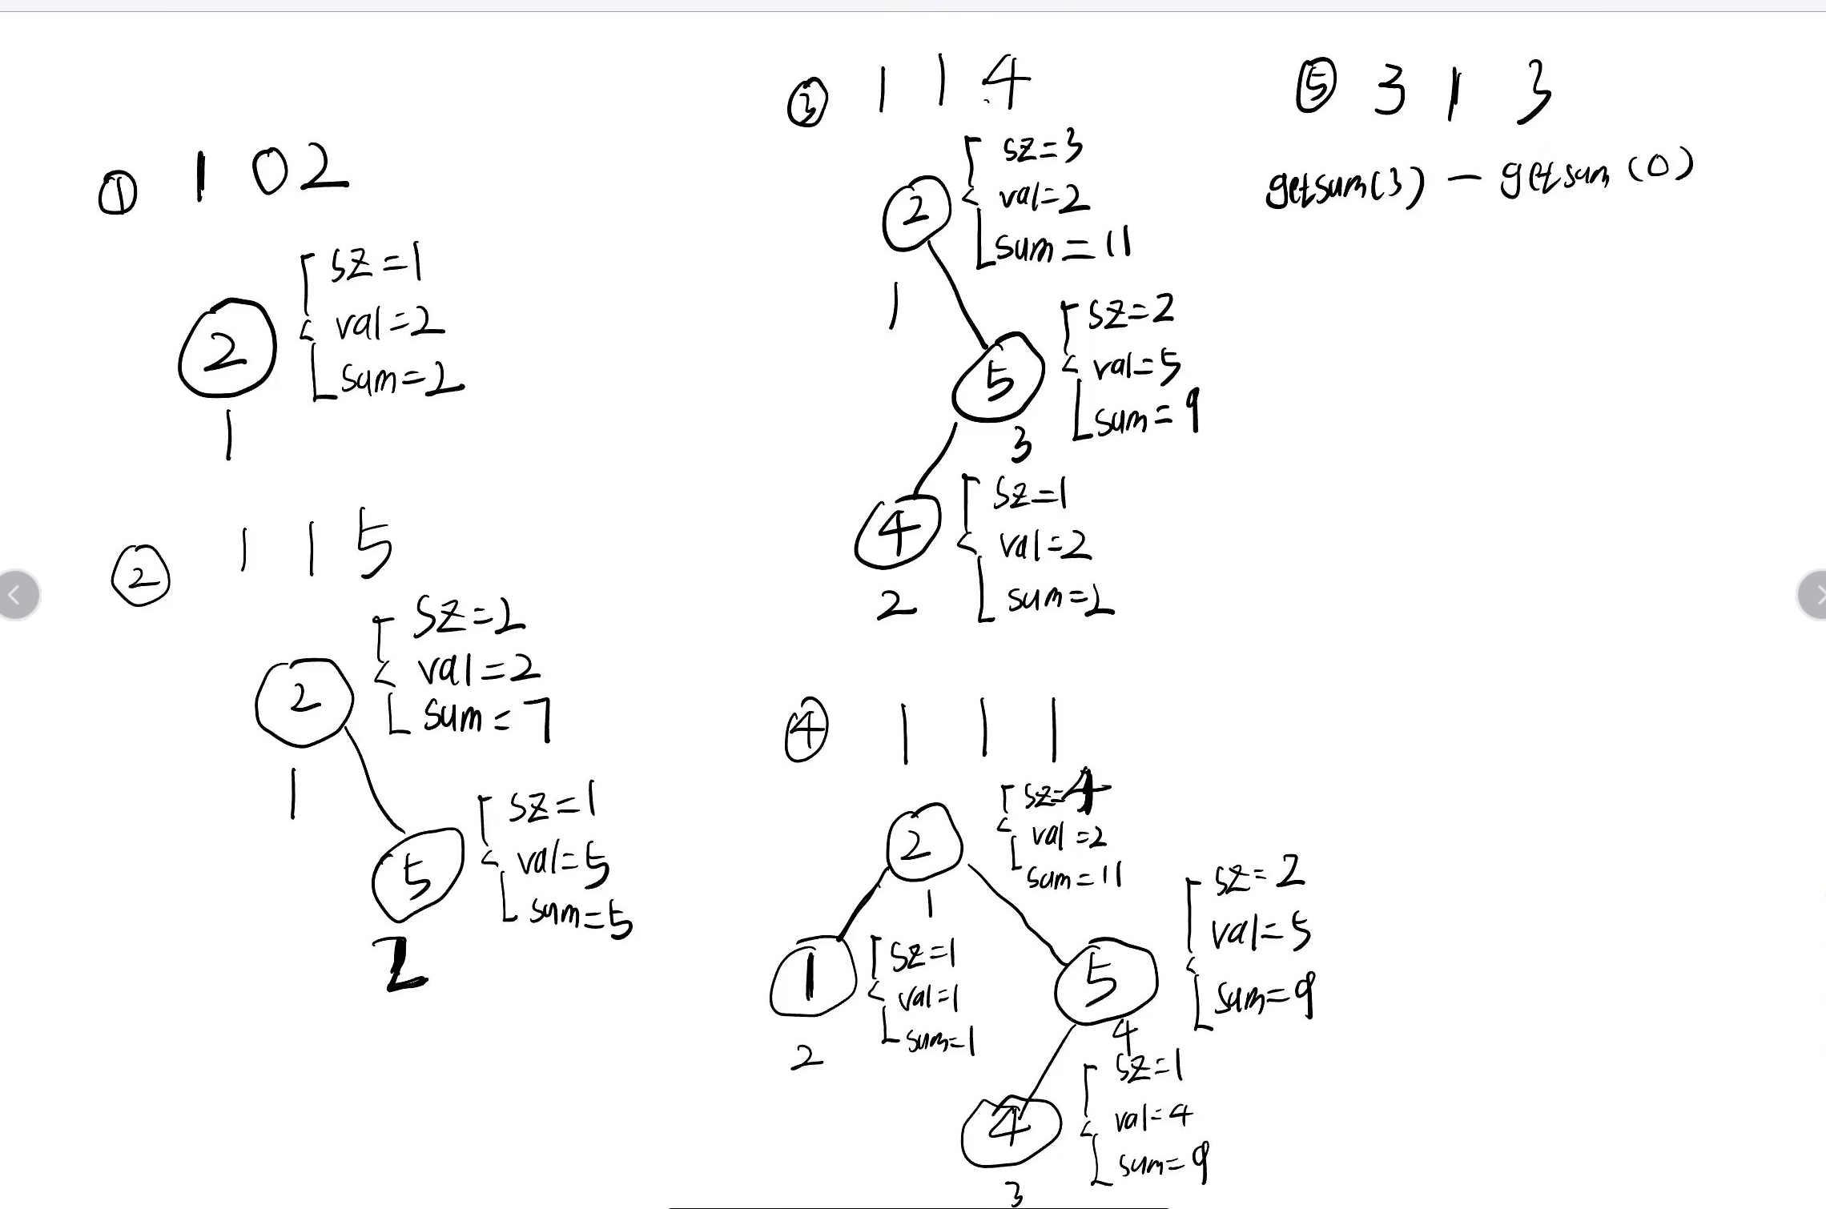
Example-1

Slide 23
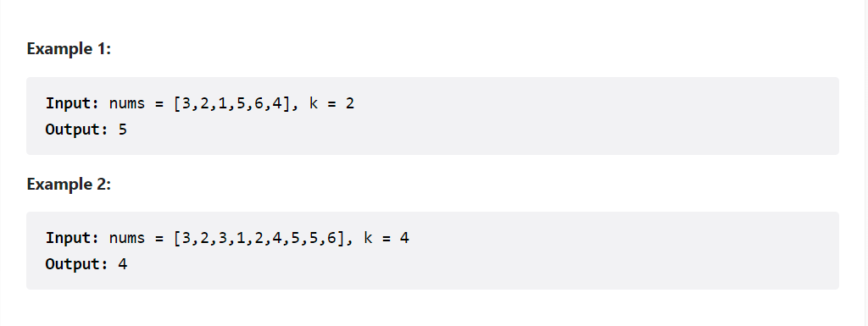
Ex1
Given an array of integers nums and an integer k, return the kth largest element of the array.
Note that you need to find the kth largest element of the array after sorting, not the kth different element.

Slide 24
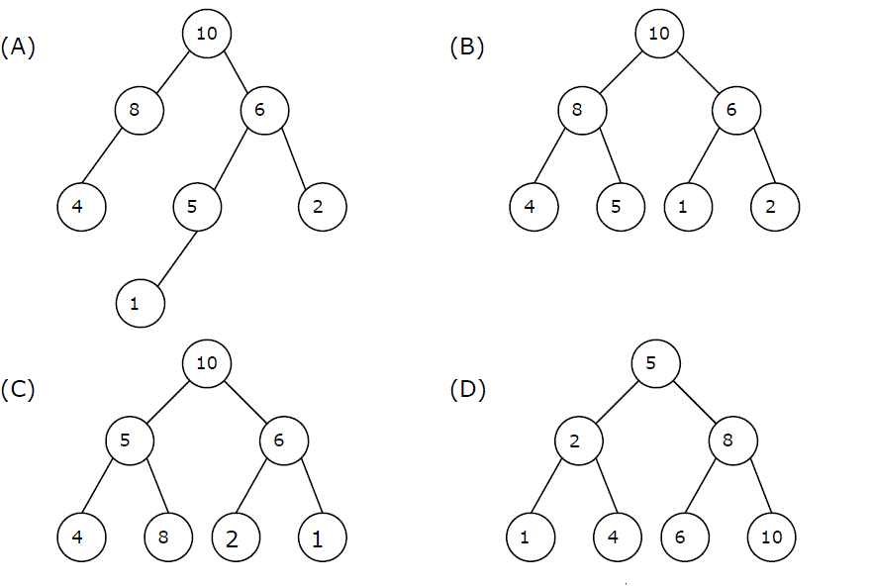
Definition of Heap
A max-heap is a heap where the value of each parent is greater than or equal to the values of its children. Which of the following is a max-heap?

Slide 25
Solution
Depending on the number of elements in the current min-heap or the size of the current element in relation to the top element of the min-heap, the discussion is divided into cases.
When there are less than k elements in the min-heap, the current element can be placed directly into the min-heap.
When the number of min-heap elements reaches k, and the current element is larger than the top element of the min-heap, the current element can be put into the min-heap.

Slide 26
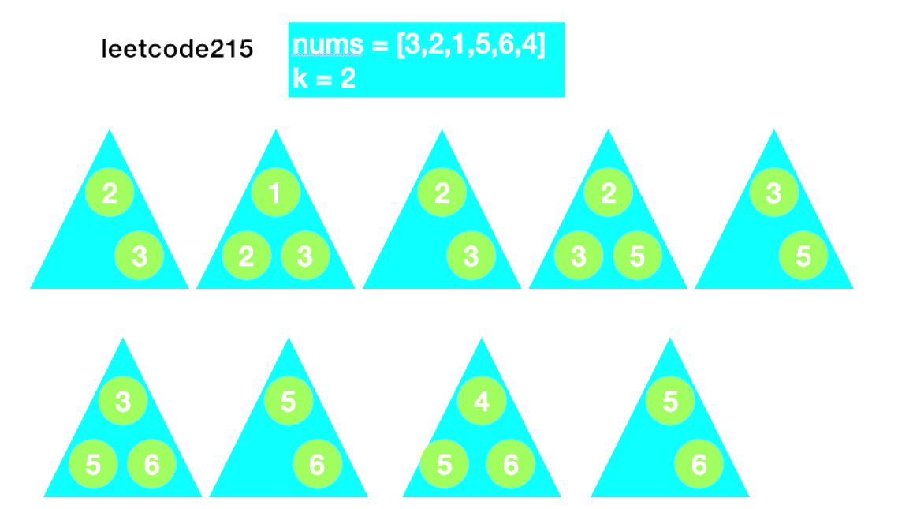
Example

Slide 27
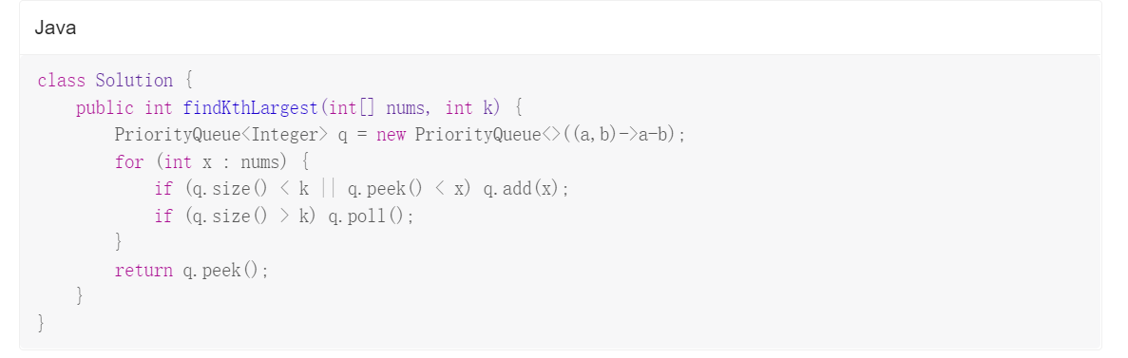
Code(Java)

Slide 28
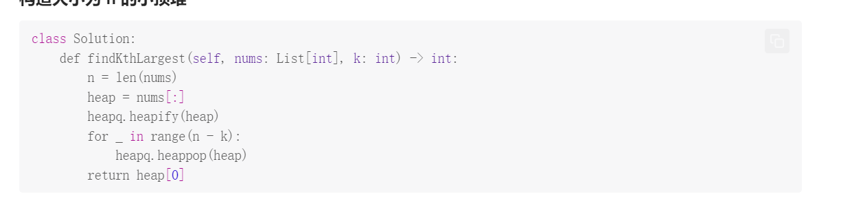
Code(Python)

Slide 29
Thanks

